Slide 1

Stereotypes: Reducing Prejudice
AEPSY Year 11 ATAR Psychology

Slide 2
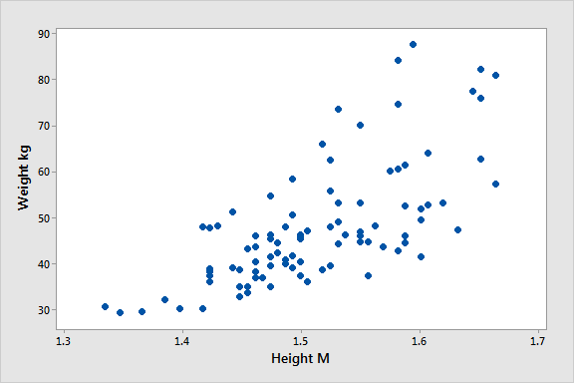
Review
Explain the difference between directional and non-directional hypothesis.
Estimate the p value of this data:
Define adaptive and developmental
neuroplasticity.
4. Describe and explain formation
and adaptation of schemas

Slide 3
Learning Intentions
reducing prejudice – contact hypothesis including intergroup contact; superordinate goals, mutual interdependence, equal-status contact

Slide 4
Success Criteria
List 4 ways to reduce prejudice.
Define and give examples of contact hypothesis including intergroup contact; superordinate goals, mutual interdependence, equal-status contact

Slide 5
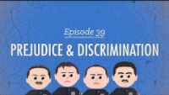

Slide 6
Reducing Prejudice: Intergroup contact
The contact hypothesis of prejudice reduction proposes that the more people within social groups interact with each other, the less prejudice they will hold toward each other.

Slide 7
Contact hypothesis…
takes time to produce beneficial results between group members and will not always be successful in reducing conflict. Conditions must be met to effectively reduce prejudice: shared goals, equal status and mutual interdependence.

Slide 8
Superordinate goals…
Goals both groups want to achieve, but that can only be achieved if both groups cooperate.
Intergroup conflict will be reduced if goals are achieved and worsened if failure to meet goals is attributed to the actions of one group.

Slide 9
Mutual interdependence…
Groups depend on each other to meet their goals, ie they are co-dependent.

Slide 10
Equal Status…
members of both groups must have roughly equal status and power.

Slide 11
Success Criteria
List 4 ways to reduce prejudice.
Define and give examples of contact hypothesis including intergroup contact; superordinate goals, mutual interdependence, equal-status contact

